Slide 1


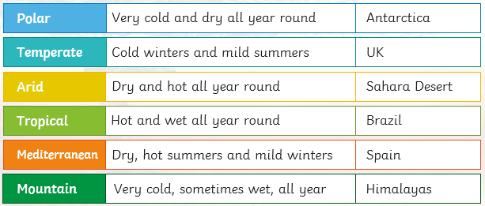
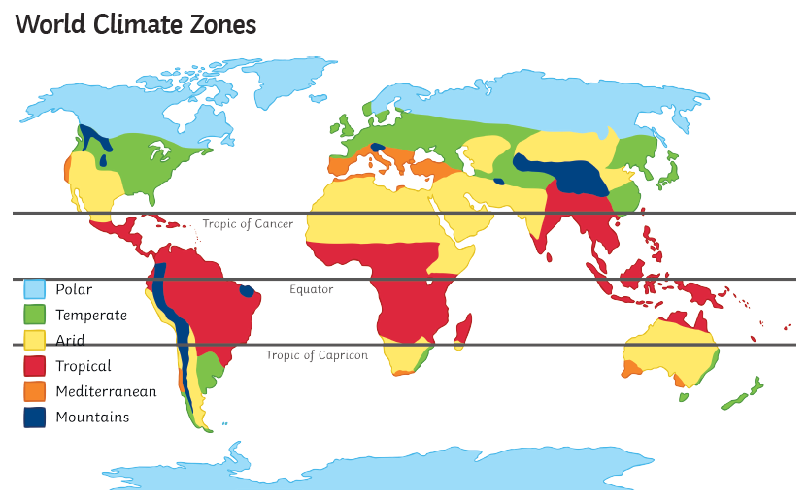
Yr 4 – Topic – Our World - Climate
Types of climate zones
VOCABULARY
1 | weather | Describes the day-to-day conditions of the atmosphere (in regard to heat or cold, wetness or dryness, calm or storm, clearness or cloudiness). Weather can change quickly - one day it can be dry and sunny and the next day it may rain.
2 | climate | The average of the weather conditions in an area over a long period of time.
3 | zone | An area that is different from other areas in a particular way.
4 | biome | A large region of Earth that has a certain climate and certain types of living things. Major biomes include tundra, forests, grasslands, and deserts. The plants and animals of each biome have adaptations that help them to survive in their particular biome.
5 | climate change | A large-scale, long-term shift in the planet's weather patterns and average temperatures.
6 | greenhouse effect | The warming of Earth's surface and the air above it. It is caused by gases in the air that trap energy from the sun.
7 | global warming | A raising of average global temperatures that is thought to be a result of increased levels of certain gases e.g. carbon dioxide and methane in the atmosphere

